Slide 1
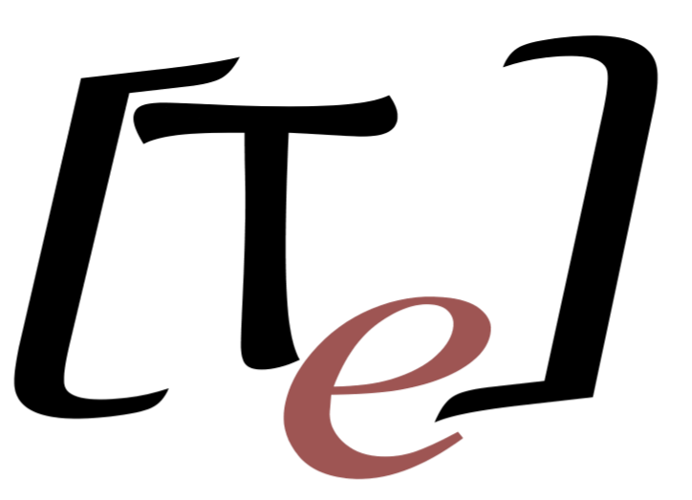
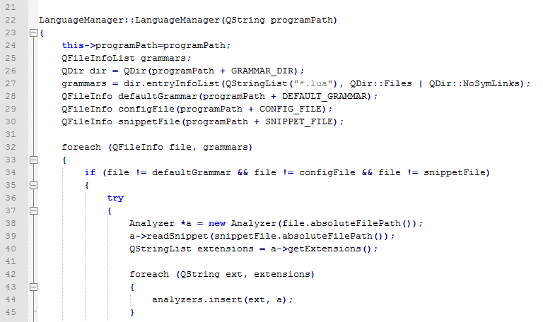


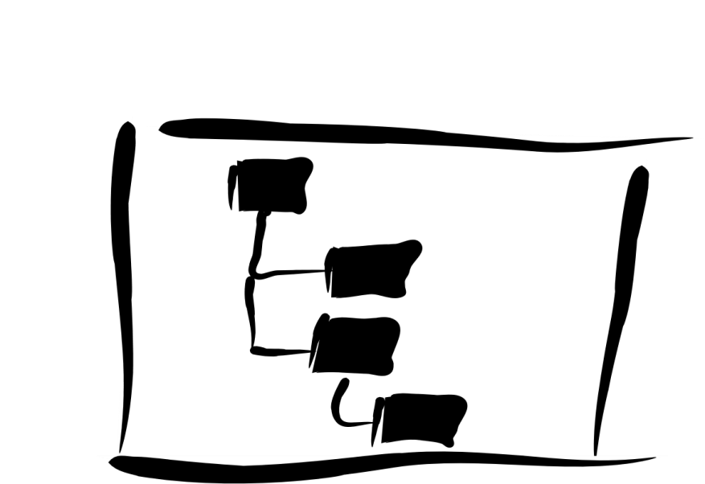



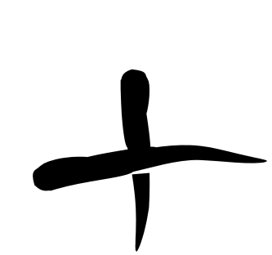


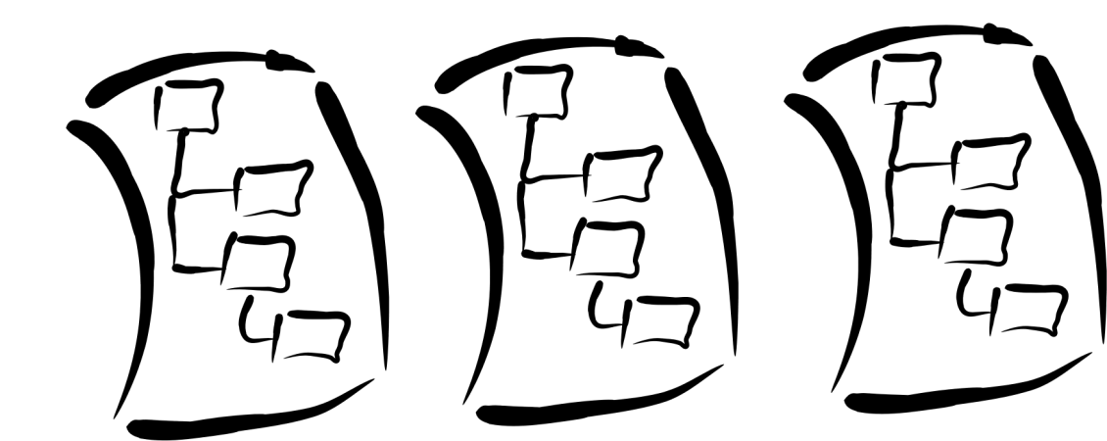

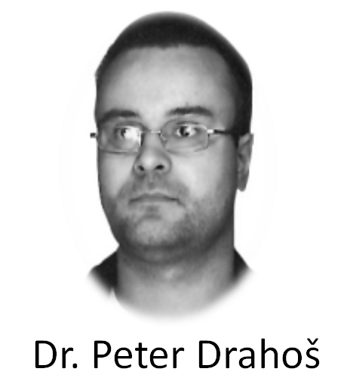


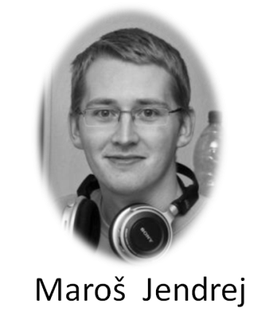


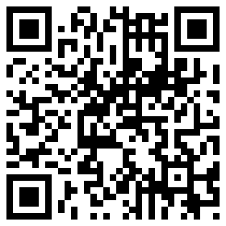



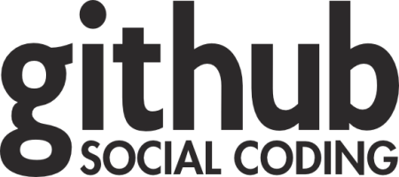


TrollEdit
Different approach of source code editing
OverView
Introduction Today editors usually use simple color highlighting without any sign of graphic enrichment features. However enriching the source code with graphic elements can be beneficial for the understanding of the structure of given code and thus lead to better understanding of its structure and meaning for the programmer. This basic observation is the driving idea behind TrollEdit. | Aproach Ako sa vytvara gramitka, že je to postavne na PG bezkontextovych gramatikach z kotrých je vytvarani AST strom, ktory nam umožnuje repezentaciu textu formou blokov. | Application Trolledit is an experimental applicaton based on multiplatform framework Qt. For parse source code and creating AST we usesing simple a scripting language LUA.
How classic text editor
see your code
How TrollEdit see source code
Why to use TrollEdit?
Your Source Code
Simple and easy to use editor
Code visualizazion as a structure of blocks
More opened files in single tab
Select and move files in workspace tab
Drag n drop whole block in and between files
Insert files (Img., Link, etc.) right into code
Write documentation into code
(Literate programming by D. Knuth)
Can works in two modes as simple text and with graphical elements
Can we see this better?
Yes, answer is TrollEdit
AST
Source
Source with graphical enhancements
Conclusion
Čo sa nam podarilo zhnutie t.j. niečoho noveho čo dopisal nexisutje.
Na vyvoji nadalej prokračujeme a budeme radi ak sa knam pripojite do skupiny a pomožete tak vytvorit niečo originalne.
S pozdravom
Team Innovators
Grammars
Team
Used technology
© 2012 Team Innovators
tp-team-10@googlegroups.com

